Slide 1


Introduction to Water Chemistry & Hardness
Course Code: ETMLCH104
Course Name: Engineering Chemistry
Program: B.Tech. (AI/ML)
Unit1:Water technology & Chemical Fuels
Dr Pratibha Sharma
Assistant Professor, Department of Chemistry
School of Basic and Applied Sciences
K.R. Mangalam University
Sohna Road, Gurugram

Slide 2

Course Overview
Unit Number: 1 | Title: Water technology | No. of hours: 6
Introduction, water analysis: Hardness-determination by EDTA method, Treatment of boiler feed water: Internal treatment (Phosphate, Colloidal and Calgon conditioning). External treatments: Ion exchange and lime-soda process, Zeolite processes. Boiler scales formation and ill effects, methods of prevention of scales. Numerical problems
Unit Number: 2 | Title: Chemical Fuels | No. of hours: 9
Fuels: Introduction, classification, calorific value (HCV & LCV), Determination of calorific value of fuel using Bomb calorimeter. Solid fuel: Coal- its analysis by proximate and ultimate analysis, Numerical problems. Liquid fuels: Refining of petroleum, Petroleum cracking, Knocking in IC engine, its ill effects and prevention of knocking. Anti-knocking agent: Leaded and unleaded petrol. Gaseous fuels: LPG, CNG and their applications.
Unit Number: 3 | Title: Battery Technology | No. of hours: 10
Introduction - Galvanic cell, electrode potential, EMF of the cell and cell representation. Batteries and their importance, Classification of batteries- primary, secondary and reserve batteries with examples. Battery characteristics - voltage, capacity, energy density, power density, energy efficiency, cycle life and shelf life. Construction, working and applications of: Ni-Cd, and Lithium-ion battery. Working principle of an electric vehicle.
Unit Number: 4 | Title: Polymer | No. of hours: 5
Basic concepts of polymer, Types of polymers, Thermoplastic & thermosetting plastics, Preparation and application of some industrially important polymers (Natural rubber, Buna S, Buna-N, Neoprene, Isoprene, Nylon-6, nylon-6,6 , Decron and Terylene). Conducting and biodegradable polymers.

Slide 3
COURSE OUTCOMES
CO1: Understand the methods for water hardness and the basics of boiler water treatment and analyze fuel calorific values and battery.
CO2: Explain the characteristics and working principles of different battery types and types of fuels.
CO3: Determine the differences between batteries and fuel cells and classify fuel cell types based on their components..
CO4: Identify between hard and soft water, solve the related numerical problems on water purification and emf and its significance in industry and daily life.

Slide 4
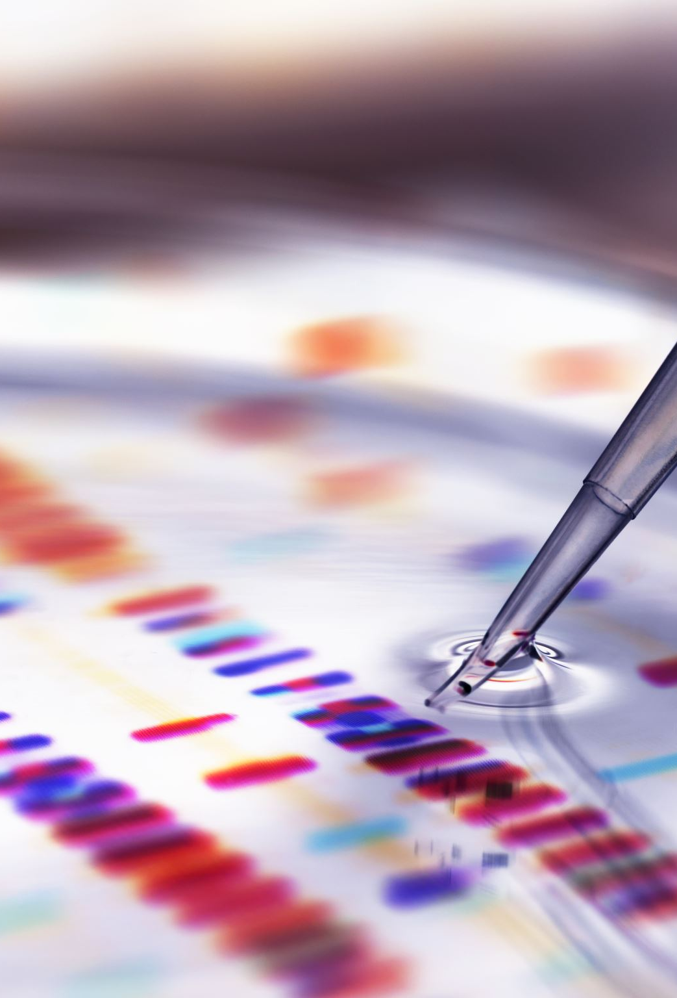
Hardness-determination by EDTA method

Slide 5
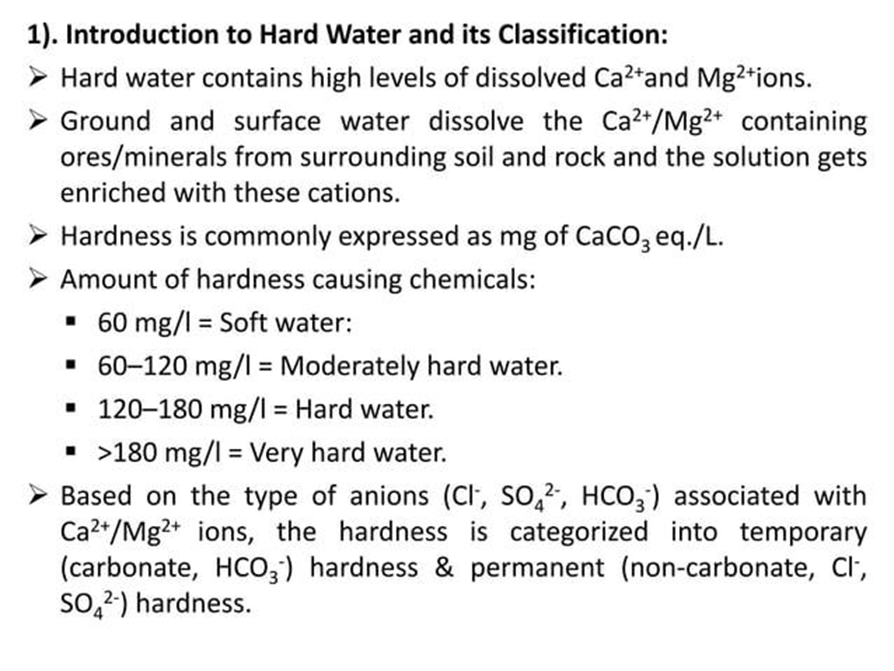
Hardness of water

Slide 6
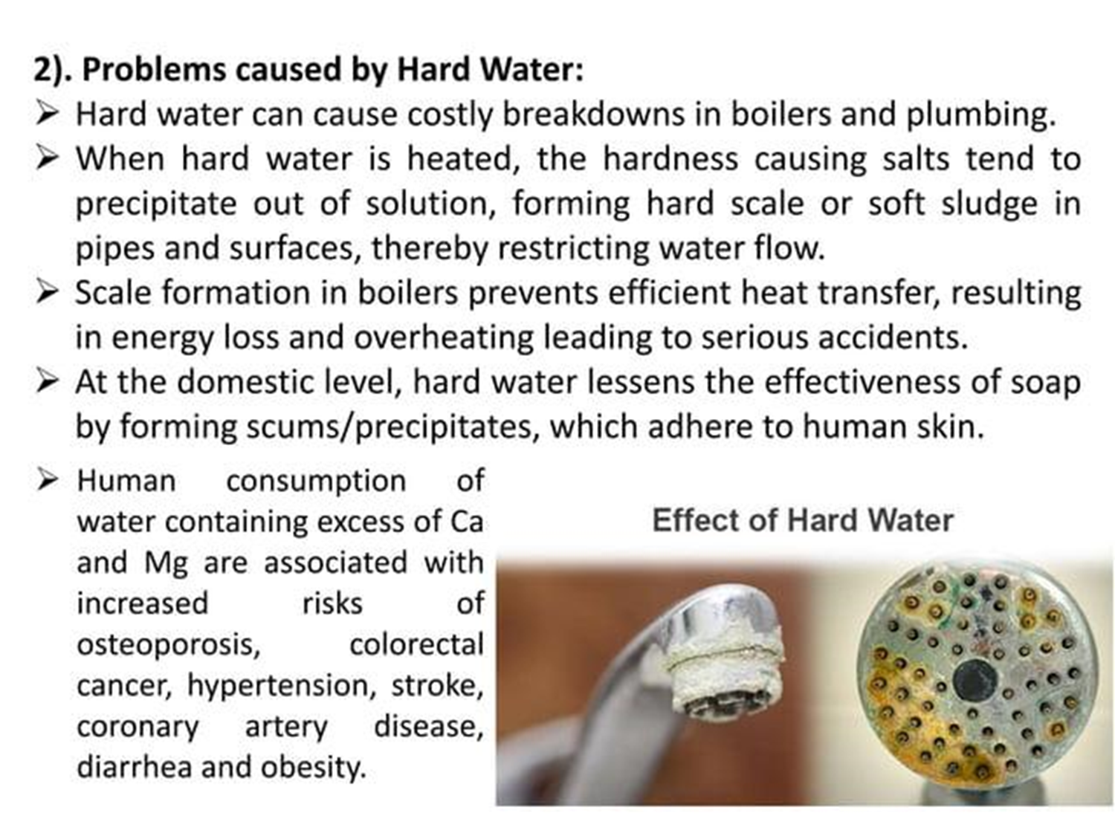

Slide 7
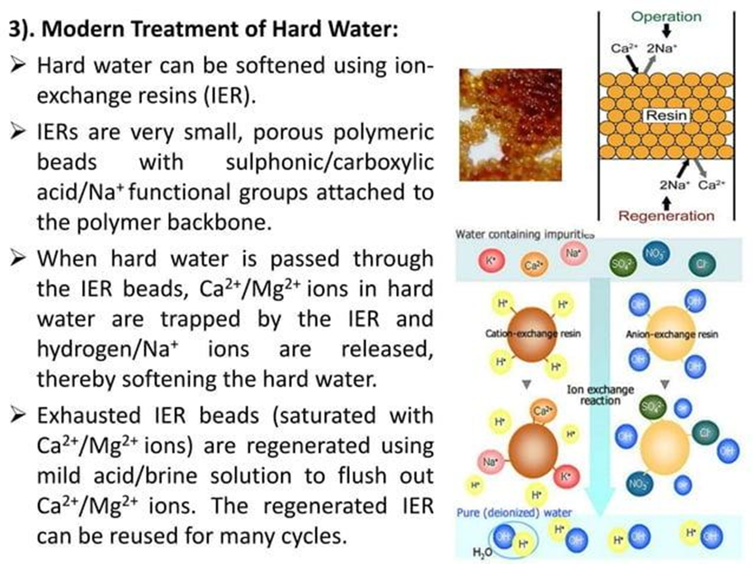

Slide 8
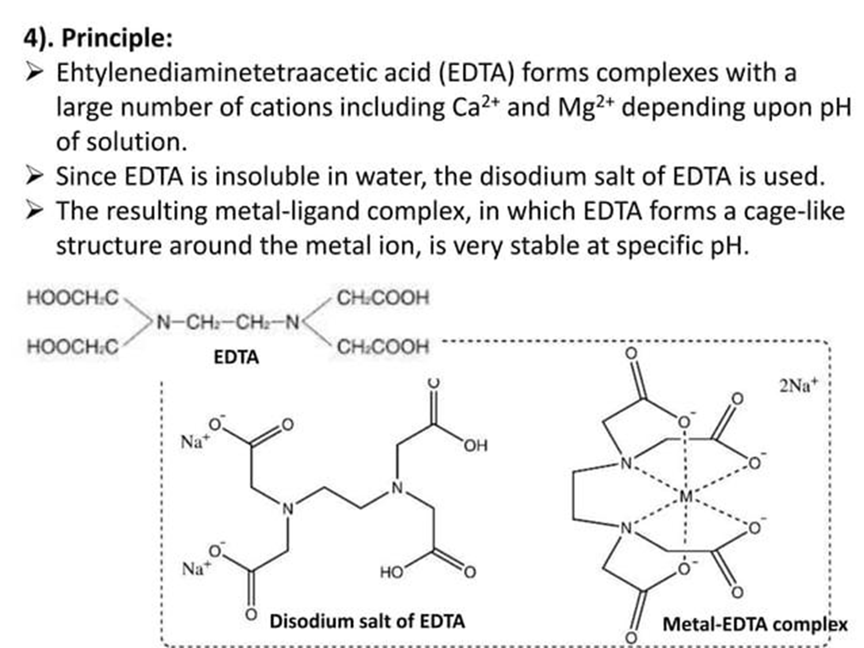

Slide 9
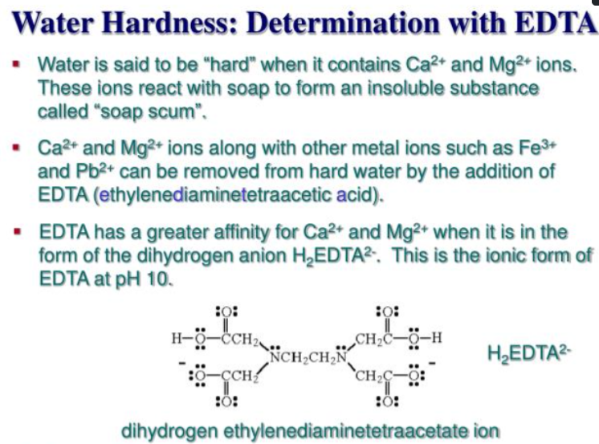

Slide 10
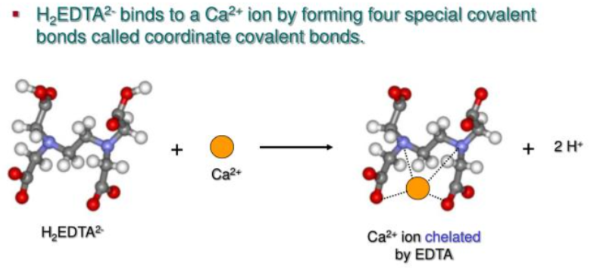

Slide 11

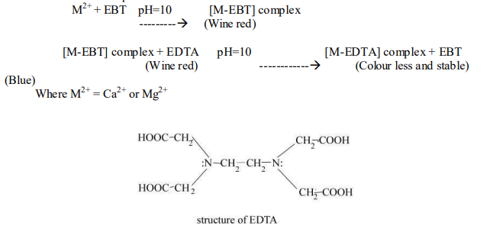

Estimation of Hardness of Water
EDTA forms a colourless stable complex with Ca²⁺ and Mg²⁺ ions in water at pH10. Ammonia buffer is used to maintain the pH. In this method EBT (Eriochrome Black-T) is used as an indicator. Initially EBT forms an unstable complex with Ca²⁺ and Mg²⁺ ions, giving wine red colour to the solution. During the titration EDTA reacts with this complex (Ca-EBT or Mg-EBT
complex), forms a stable complex (Ca-EDTA or Mg-EDTA) and releases the blue EBT into the solution. Hence the end point is wine red to blue colour

Slide 12
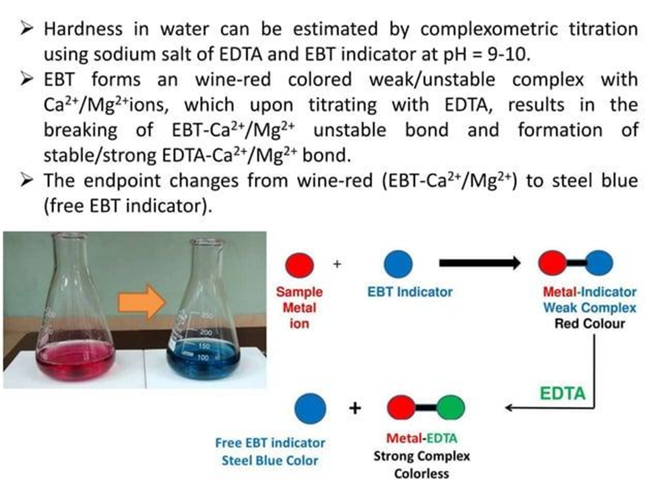

Slide 13
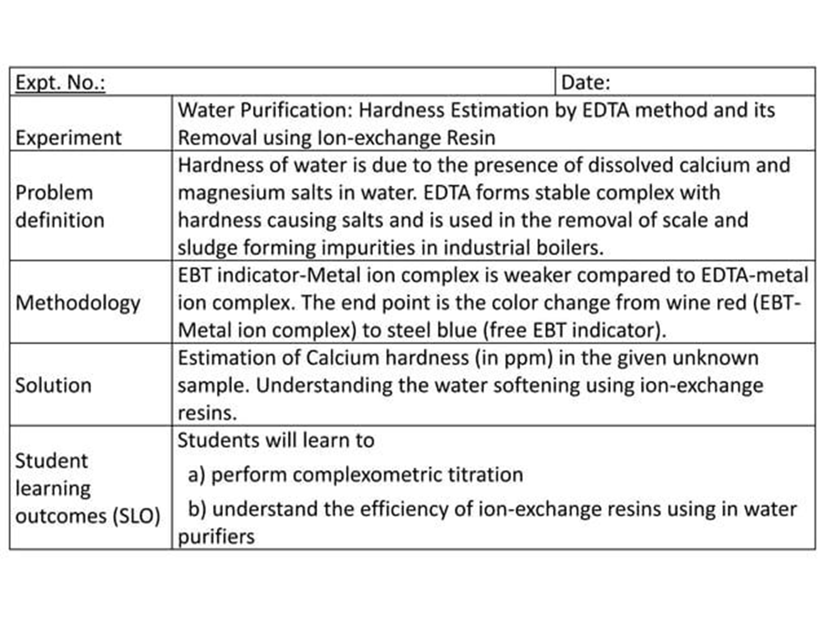

Slide 14
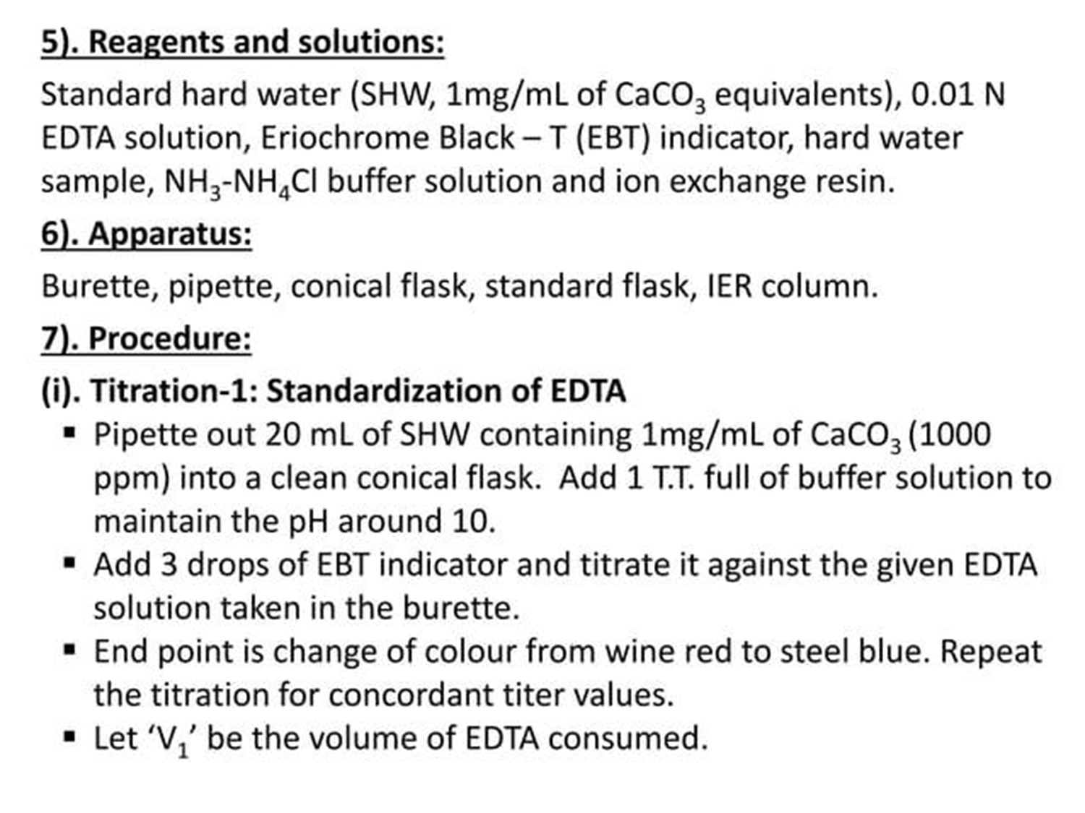

Slide 15
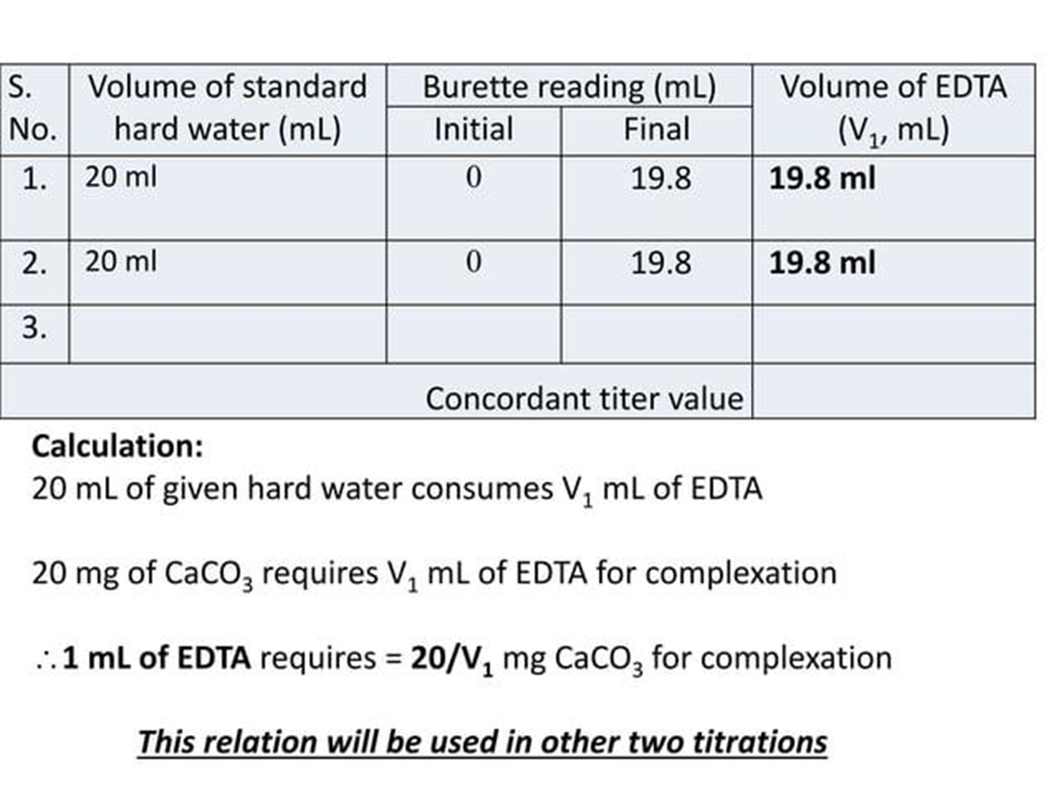

Slide 16
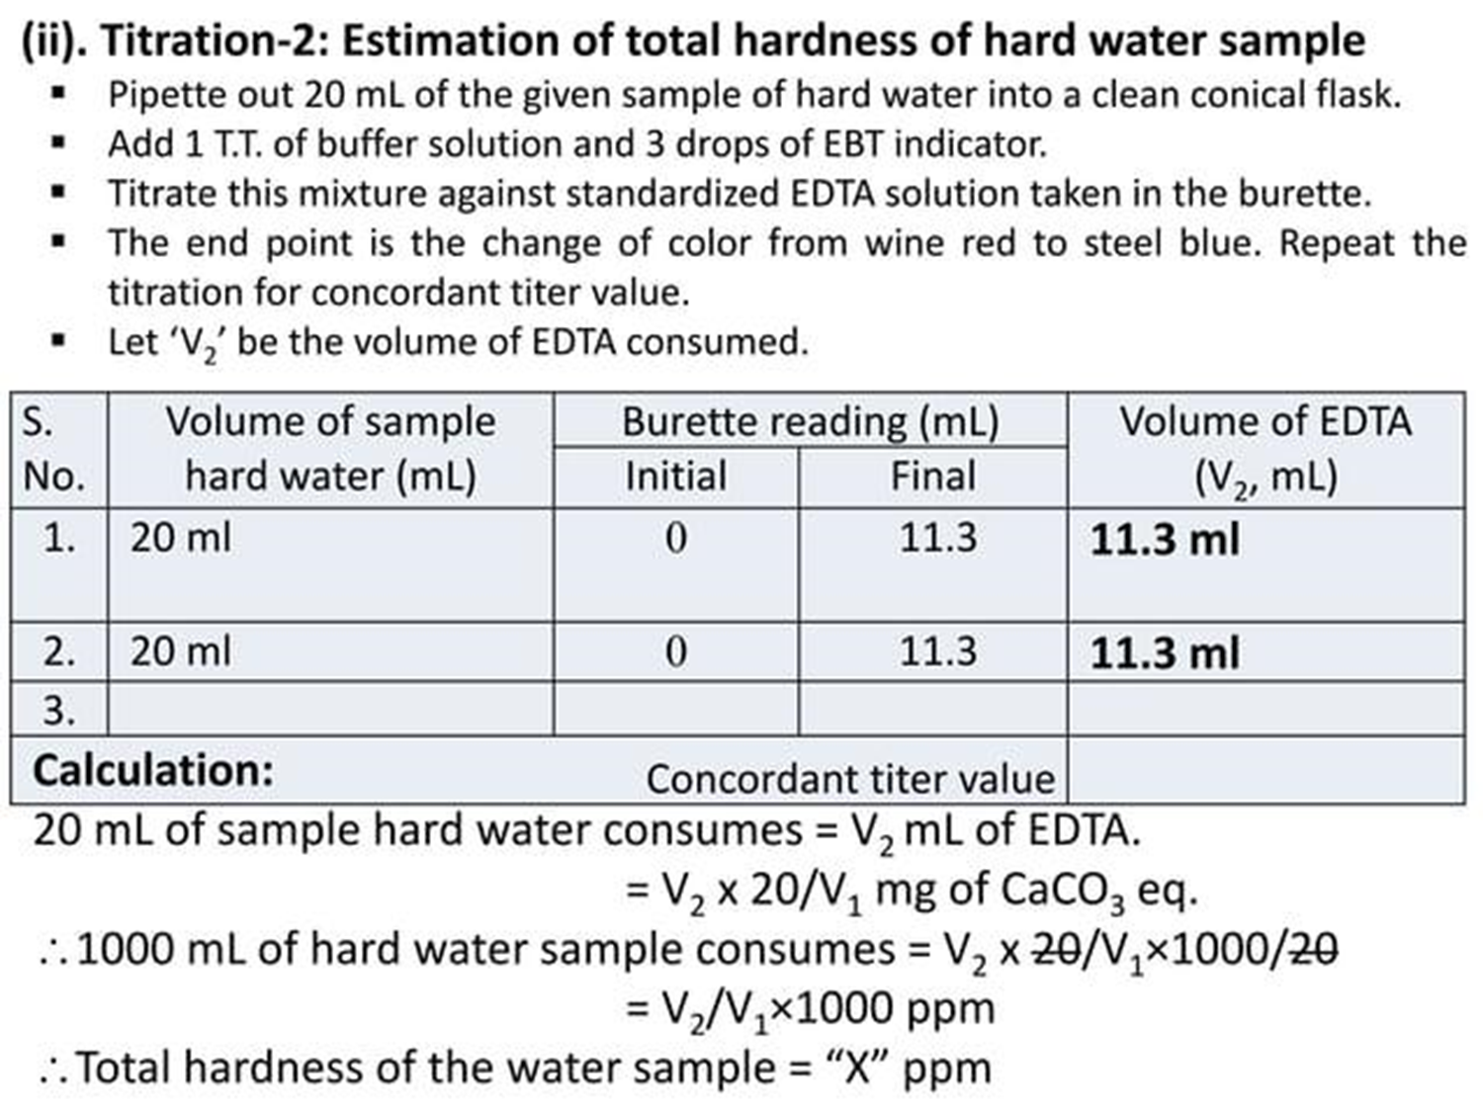

Slide 17
Estimation of Hardness of Water
Various steps involved in this method are;
Preparation of standard hard water (1mg of CaCO₃ per 1 mL of water).
2. Standardization of EDTA solutions:
Pipette out 50 mL of standard hard water in a conical flask.
Add 10-15 mL of buffer solution and 4 to 5 drops EBT indicator.
Titrate with EDTA solution, till wine red colour changes to clear blue. Let volume used be V₁ mL.
3. Titration of unknown hard water:
Titrate 50 mL of water sample just as indicated above. Let the volume used be V₂ mL.
4. Titration for permanent hardness:
Take 250 mL of the water sample in a large beaker.
Boil it, till the volume is reduced to about 50 mL.
Filter, wash the precipitate with distilled water, and collect the filtrate and washings in a 250 mL measuring flask.
Finally, make up the volume to 250 mL with distilled water.
Then, titrate 50 mL of boiled water sample just as in step (2). Let the volume of EDTA used be V₃ mL.

Slide 18
Estimation of Hardness of Water
Calculations:
50 mL of standard hard water = V₁ mL of EDTA
50 mg of CaCO₃ = V1 mL of EDTA
1 mL of EDTA = 50/V₁ mg of CaCO₃
Now 50 mL of given hard water = V₂ mL of EDTA =V2*50 X mg of CaCO₃
1 L (1000mL) of given hard water = 1000V₂/V₁ mg of CaCO₃ eq
Total hardness of water = 1000V₂/V₁ mg/L = 1000V₂/V₁ ppm
Now 50 mL of boiled water = V₃*50 X mg of CaCO₃ / V₁
1 L of given hard water = 1000V₃/V₁ mg of CaCO₃ eq
Permanent hardness = 1000V₃/V₁ mg/L = 1000V₃/V₁ ppm
And Temporary hardness = Total hardness – permanent hardness
Temporary hardness =1000(V₂-V₃) ppm/ V₁

Slide 19
Take away of the session
Purpose: Measures total hardness (Ca²⁺ and Mg²⁺ ions) in water.
Principle: EDTA forms a stable, colorless complex with Ca²⁺/Mg²⁺ ions in a titration.
Indicator Used: Eriochrome Black T (EBT) – forms a wine-red complex with metal ions.
End Point: Color changes from wine red to blue when all hardness ions are complexed.
Buffer Solution: Maintains pH around 10 for accurate results.

Slide 20
Questions
What is the function of EDTA in hardness determination? A. Indicator B. Buffer C. Complexing agent D. Precipitating agent
Which indicator is used in EDTA titration for hardness? A. Methyl orange B. Phenolphthalein C. Eriochrome Black T D. Litmus
What is the color change at the end point of EDTA titration? A. Blue to red B. Red to yellow C. Red to blue D. Yellow to colorless
What pH is maintained during the EDTA titration of water hardness? A. 4 B. 7 C. 10 D. 12
Total hardness is usually expressed in terms of: A. MgCl₂ B. CaSO₄ C. CaCO₃ equivalent (mg/L or ppm) D. NaHCO₃

Slide 21
References
Engineering Chemistry by Jain and Jain.

